Slide 1
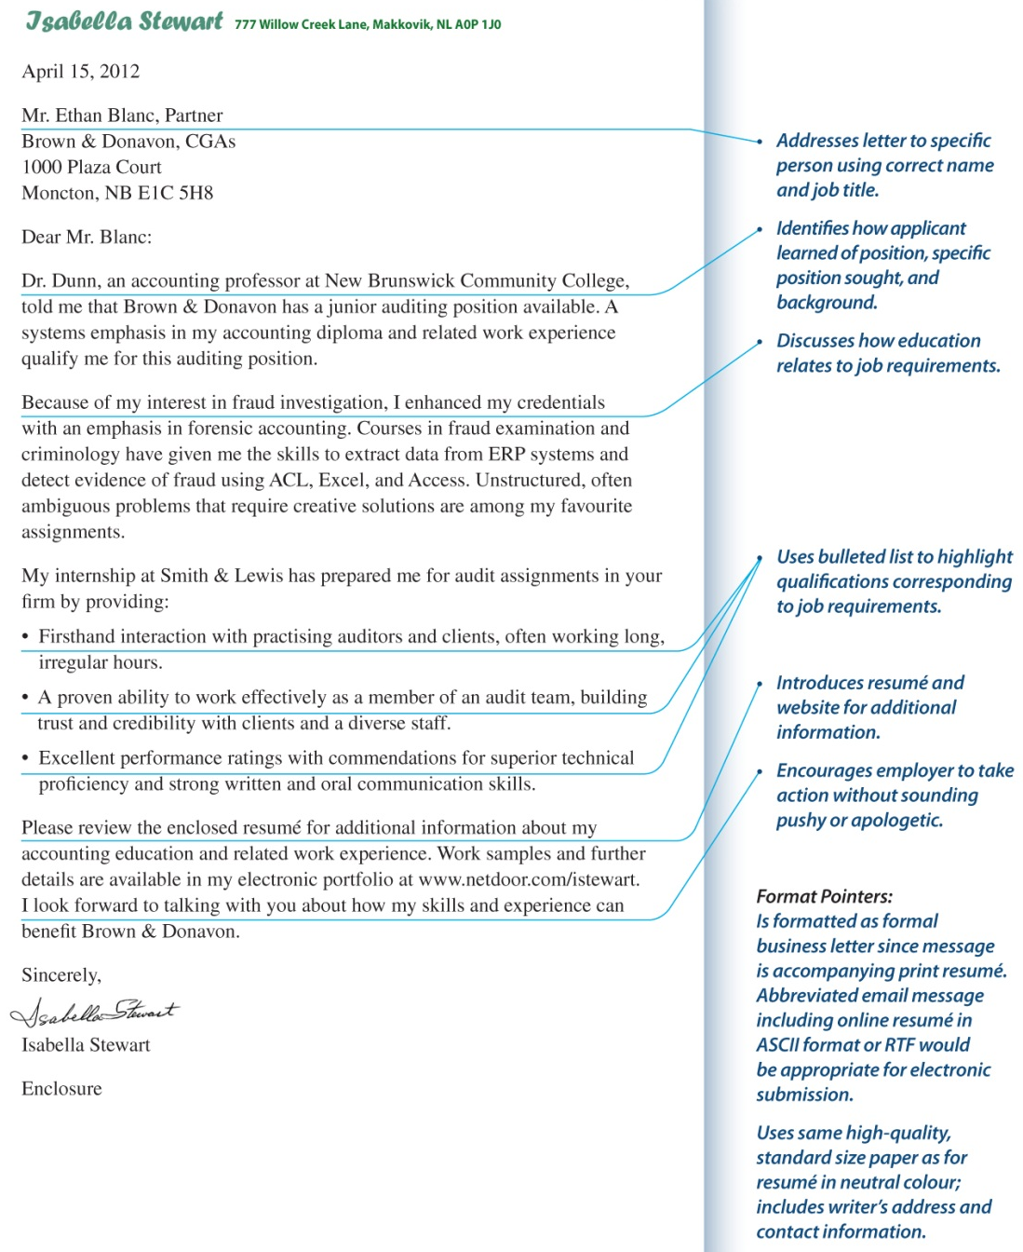
Add phone number and email.

